Slide 1
JobMatch.com Mock-up Web Pages
Prepared for: | Jim Buchan
Prepared by: | Mao Chuan Li(14854389) Chen Xiao Yu(15855860)
Submit Date: | 2015/05/22
Paper Name: | Software Requirement Engineering
Paper Number: | 409220

Slide 2

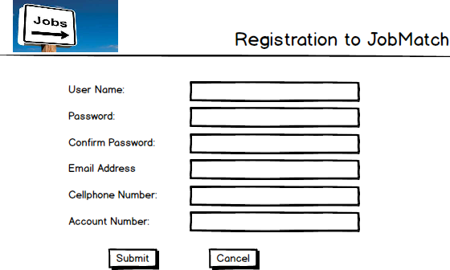
User Story 1:
As a service seeker, I want to Enter my personal details only once so that JobMatch can remember me

Slide 3
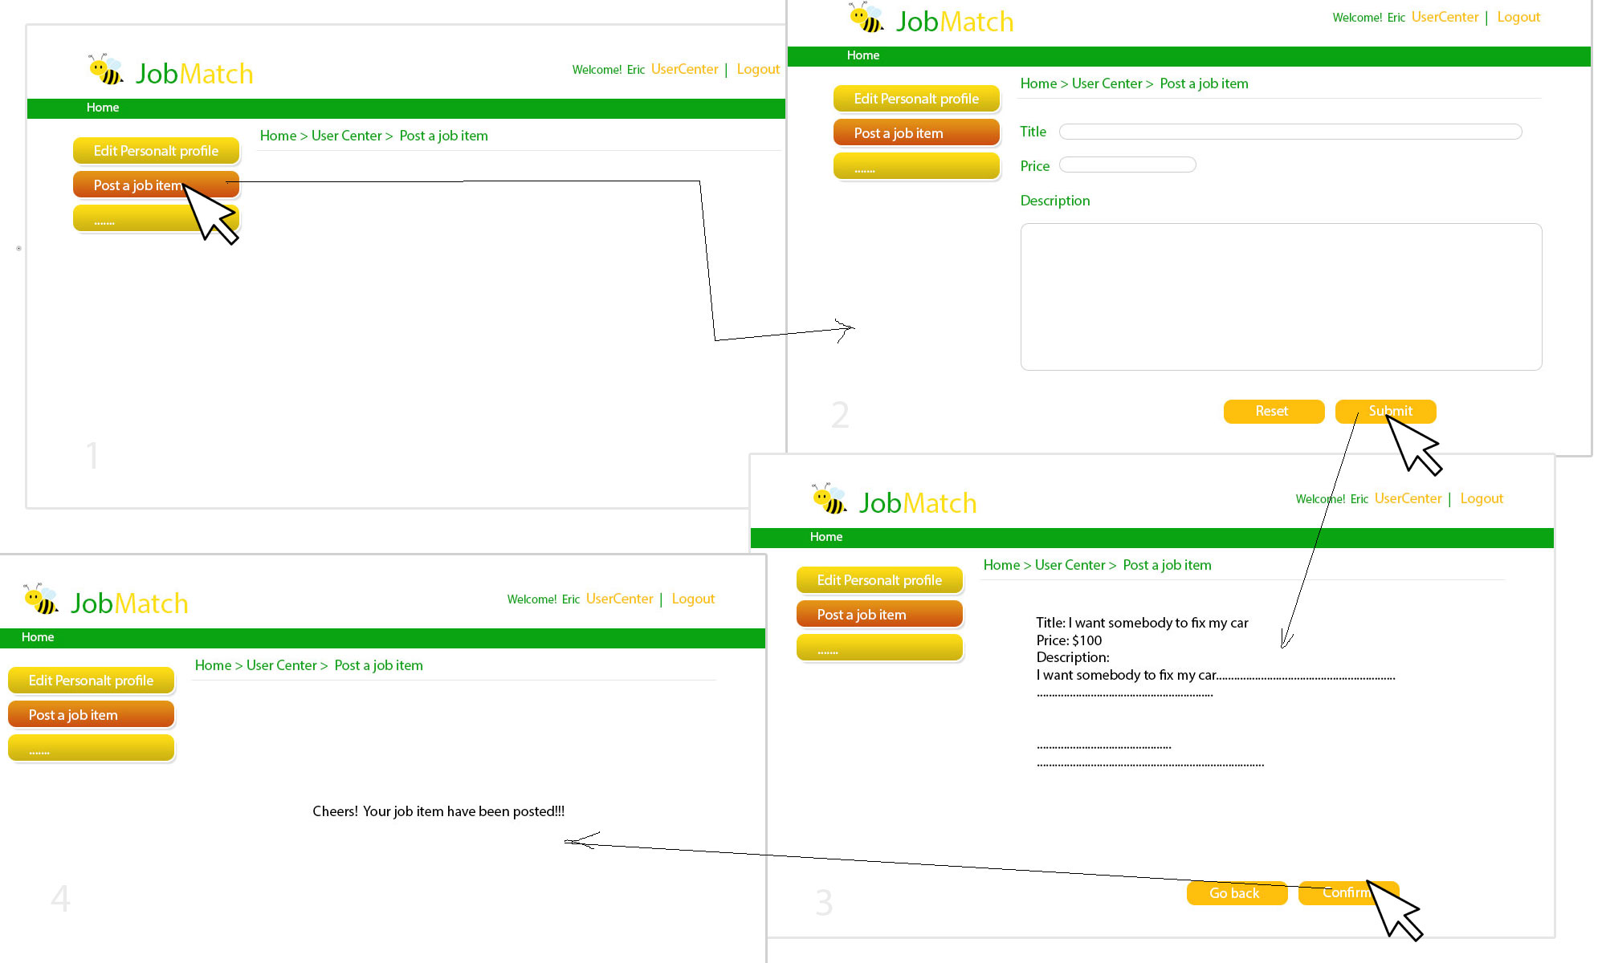
User Story 2:
As a service seeker, I want to post a job with details so that Job providers can find it

Slide 4
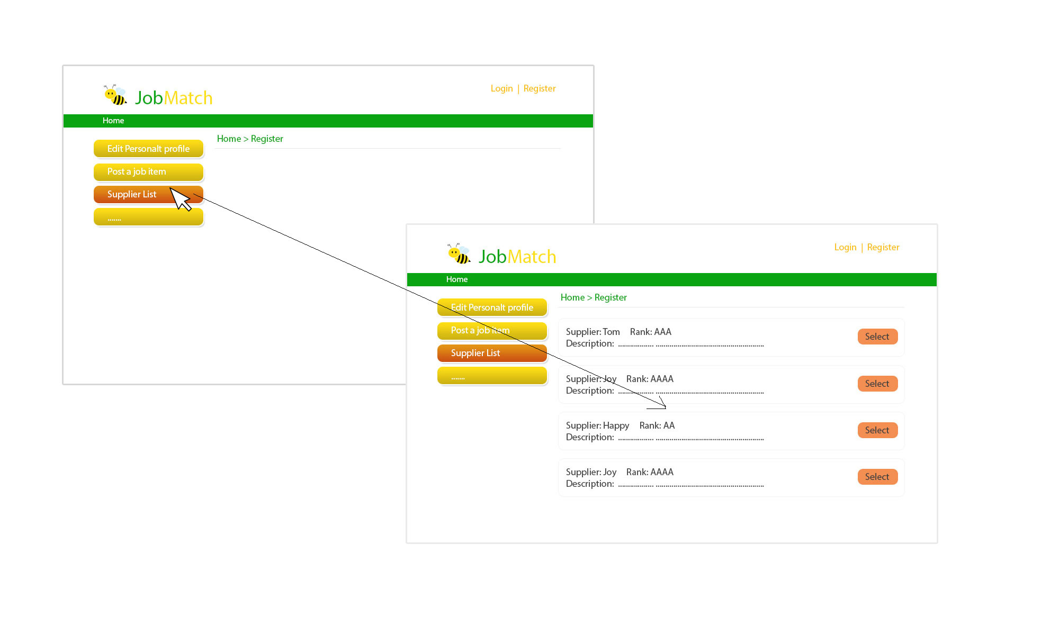
User Story 3:
As a service seeker, I can select one provider from the list so that I can find the best provider for my job

Slide 5
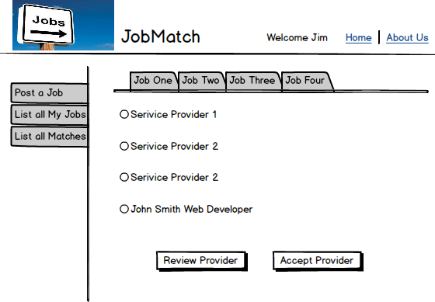
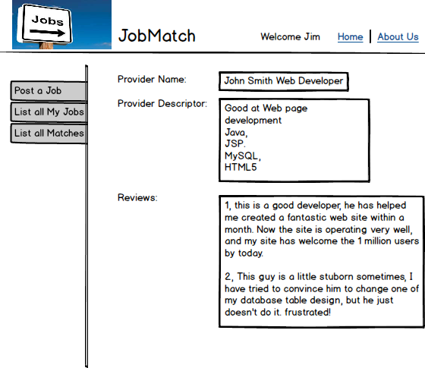
User Story 4:
As a service seeker, I want to check the reviews of a Provider
2, Select one Job
1, List all Job matches
3, Select one Provider
4, Click the button
5, Provider detail shown

Slide 6
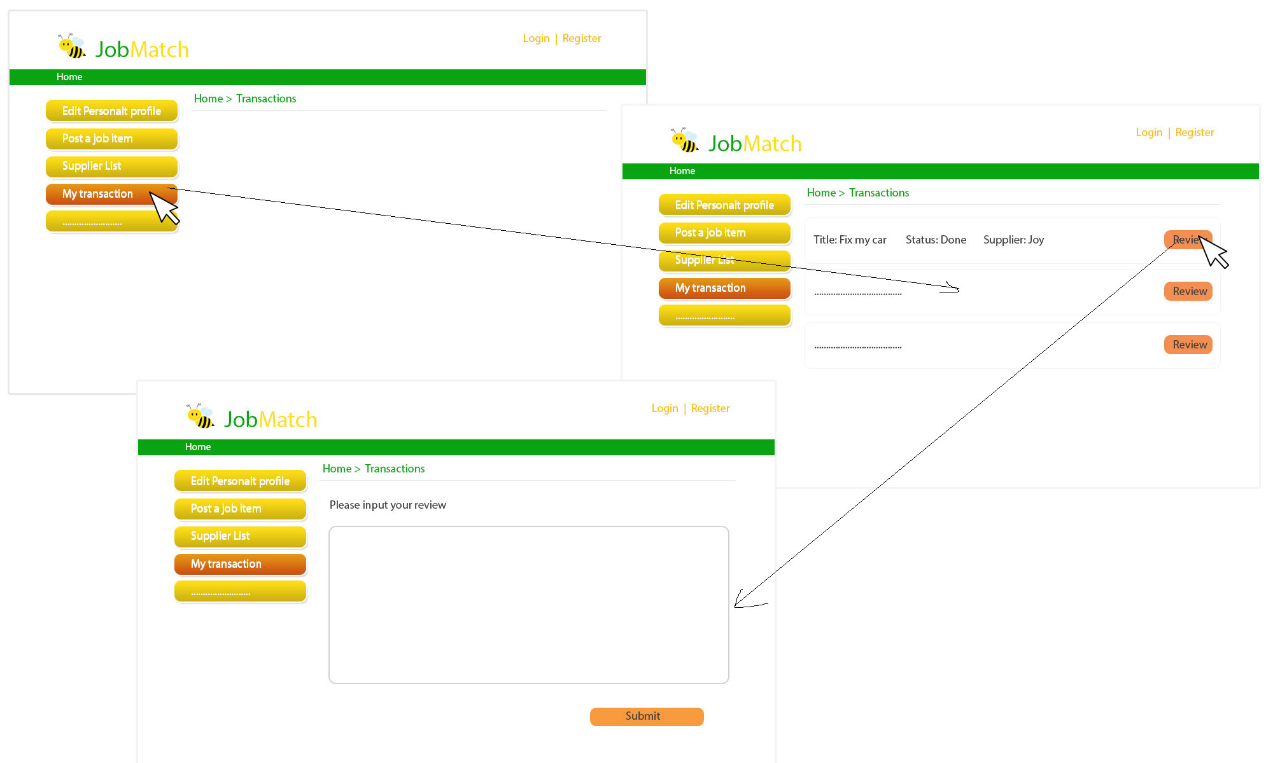
User Story 5:
As a service seeker, I want to enter review on a provider according to the job he has done

Slide 7
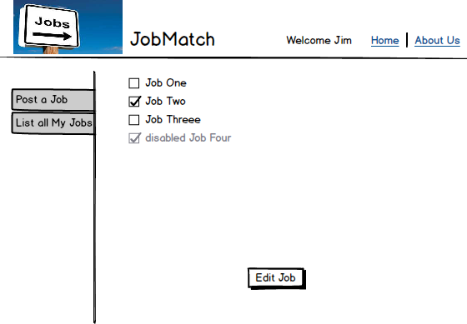
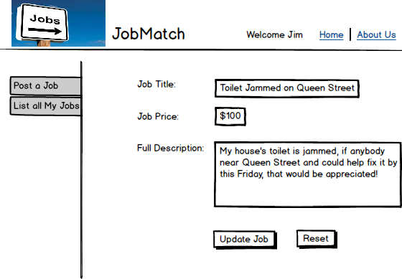
User Story 6:
As a service seeker, I want to Modify my job detail so that it is more clear to providers
1, Select the Job to Edit
2, Click the Edit Button

Slide 8
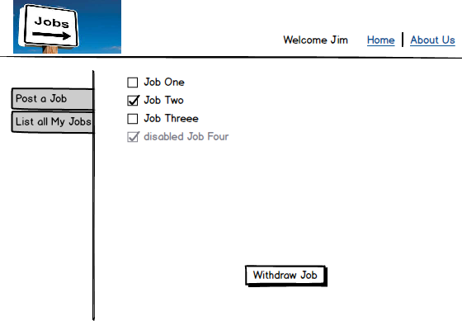
User Story 7:
As a service seeker, I want to withdraw a job when the Job is invalid.
2, Select the jobs invalid
1, Click this button to show all jobs
3, Withdraw

